Slide 1






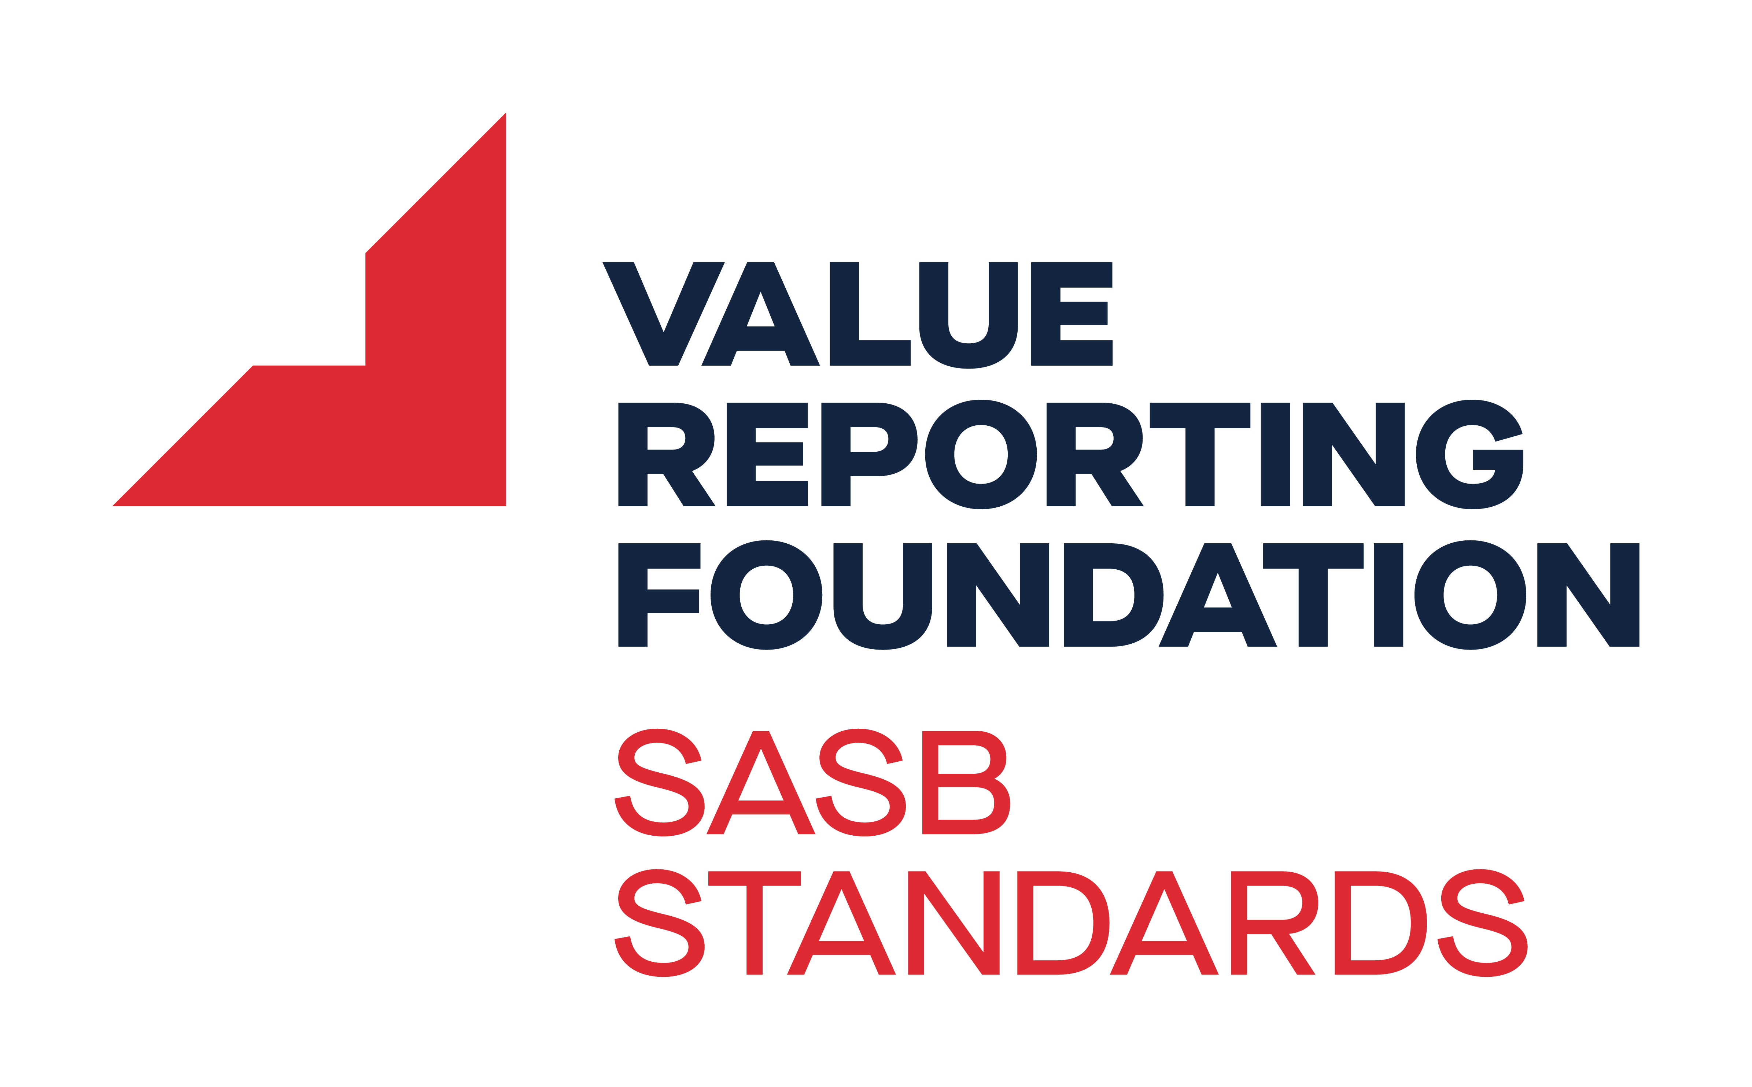








The State of Play
Scope
We need Relevant, Reliable and Comparable data!
The introduction of new laws, standards and guidelines bring forward challenges in Environmental, Social and Governance reporting. With complex and overlapping disclosure requirements, it is hard to provide control over Sustainability reporting without a trusted end-to-end solution.
Audit
Boundaries
Timelines
Tagging
Location
Materiality
Severely simplified,
and non-exhaustive
Sustainability (ISSB)
Notes:
A quick look at the regulatory front and we see many more reasons to professionalize
In the EU, on the back of PA and EUGD, came the CSRD, EUTAX and SFDR
In the US, among others (SA,JPN,HK), it’s the stock market regulators (mostly TCFD, now going IFRS)
But with a much wider scope we see, IFRS, GRI and many other industry frameworks
Even non-profits like CDP, Ecovadis and SBTI are likely to become business requirements
Standards and Frameworks:
Overlap and complement
Some only E (IFRS, TCFD, SEC, CDP), some full ESG (CSRD, GRI)
Some single (IFRS, TCFD, SEC), some double materiality (CSRD, GRI)

Slide 2
From gathering data to delivering results
Design principles to a non-financial record-to-report process
Import data from source systems through direct connections and file-based uploads
Convert raw data into ESG metrics and calculate Key Performance Indicators to report progress.
Interact and consume information in built-for-purpose UX and share insights to collaborate and enact change
Utilize self-service data exploration and auto-insights to review performance
Connect & Collect
Prepare
Transform
Model & Align
Review & Explore
Predict & Plan
Experience
Report & Act
Prepare, enrich, rename and control the data with purpose-built tools.
Blend ESG data to create unified business semantics and manage performance, risk and opportunities
Model, predict and plan on various ESG topics/levels using advanced machine learning capabilities
Report to internal and external stakeholders, Act and drive change, and provide appropriate assurance
2
Copyright © 2024, Oracle and/or its affiliates | Confidential: Internal
Notes:
For or easiness' sake I will limit myself to speak about carbon accounting and reporting, but just know that the features I speak of translate to social and governance reporting as well. For most companies coming out of the DMA, they try to figure out“ what KPIs do we need to report”, to “what data points are underneath those KPIs” to “how do we gather that data, and bring it into a structure process” akin to a financial record-to-report process. Internally it is quite likely there will be applications gathering some of the information required. External data often proves to be quite a bit harder.
One of the other big parts of the implementation is really focused on the transformation of data, so, once the data is in EPM what are the calculations we need to do to get to the impact metrics. Severely dumbing it down, Carbon accounting is just a systematic framework to translate operational activities into emissions. So having the activity data as we wanted it and combining that with the right emission factors, we turned that into simple rules.
Notes:
Fundamentally it seems to be a data problem
The data journey resembles a Record to Report cycle – but with vastly more complex data coming from all kinds of sources
Most businesses are not so worried about that last mile reporting – more so where to record the data and how to get it in one place
Businesses are starting to realize that beyond having to calculate the entity metrics they will be asked about their product metrics by their customers

Slide 3



Enterprise Sustainability Management
Productivity
Accountability
Efficiency
Gather data
Control data
Use data
True ESM helps integrate financial and non-financial data to fulfil more than just your reporting requirements; it also helps you plan and manage your sustainability practices – now and into the future.
Collect, aggregate, and manage sustainability disclosures from across the enterprise using AI and embedded intelligent process management.
Import data with full data lineage to reduce reporting and compliance risk, improve transparency and accuracy and satisfy stakeholder demands.
Use state-of-the-art reporting, planning and analytics features to manage sustainability reporting and support sustainable goals.
Notes:
Gather data: Minimize time input, Maximize output
Control data: Minimize dependency, Maximize accuracy
Use data: Minimize resource waste, Maximize results

